Slide 1


Bulls V Thunder:
An Eastern vs Western conference showdown
By Paolo Natividad
Images are from wikipedia

Slide 2
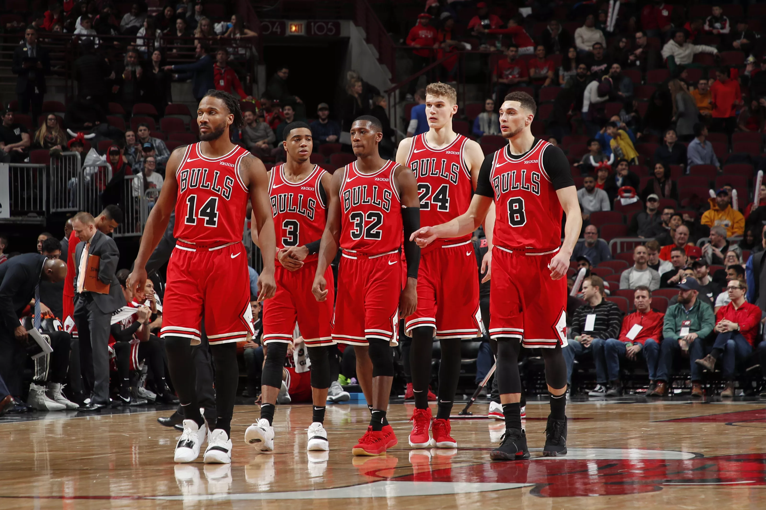
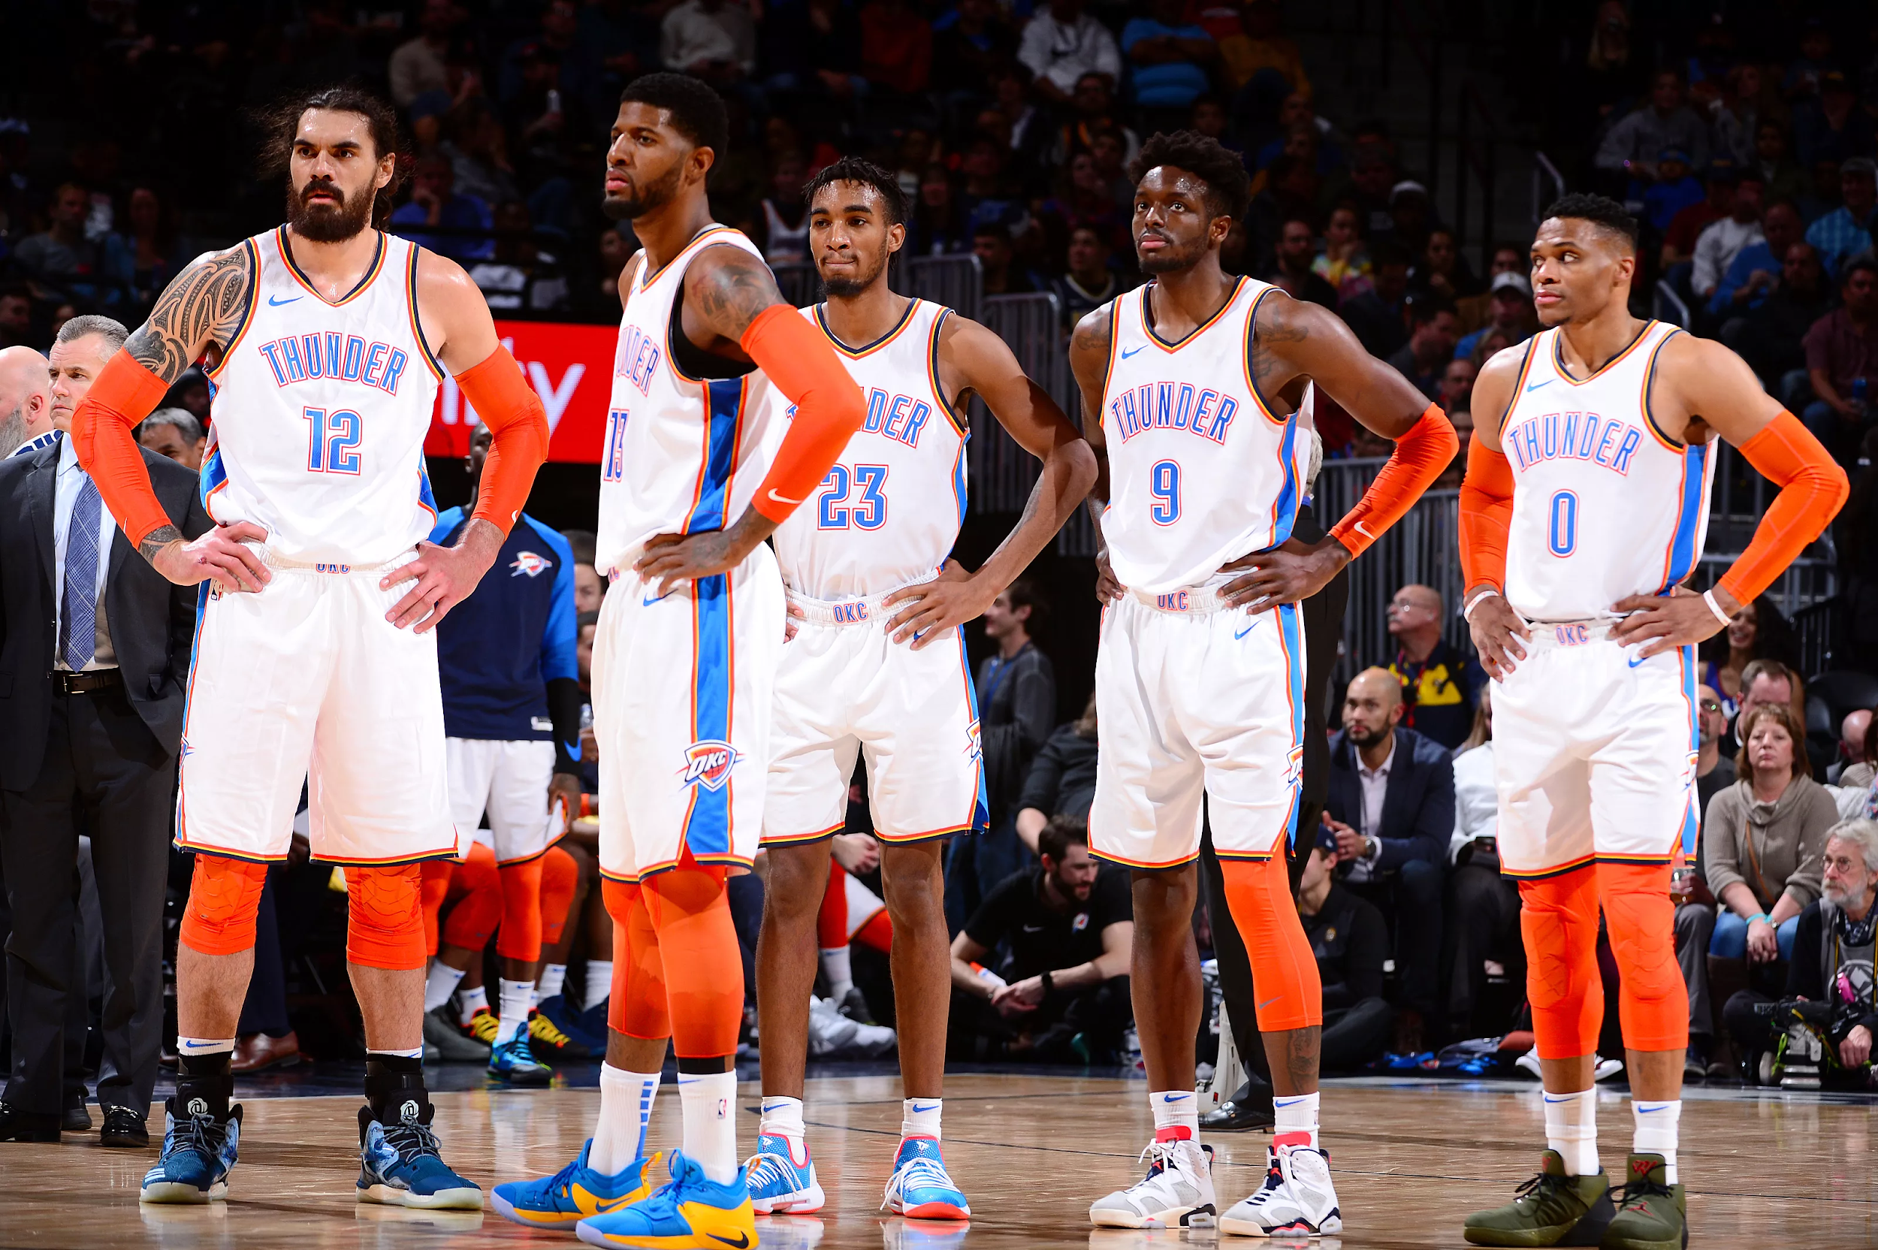
Problem:
We are to make a binary classifier model out of scrapped Reddit posts to determine which two subreddits(of our choosing) the posts are from. The two subreddit chosen were: r/ChicagoBulls and r/Thunder
Bulls image is from https://pippenainteasy.com/2019/02/12/chicago-bulls-3-biggest-2018-19-positional-needs-remaining/
Thunder image is from https://thunderousintentions.com/2018/12/17/okc-thunder-player-grades-revenge-served-via-oust-melee/
Notes:
Bulls image is from https://pippenainteasy.com/2019/02/12/chicago-bulls-3-biggest-2018-19-positional-needs-remaining/
Thunder image is from https://thunderousintentions.com/2018/12/17/okc-thunder-player-grades-revenge-served-via-oust-melee/

Slide 3

Scraping
Used Pushshift as scraper
Scraped from 3 years ago to the present
Parameters for scrape:
Timespan
Limit
Number of Comments in Post
Did not use Score as a parameter
Image is from http://i.imgur.com/YY7S7t8.png
Notes:
Push shift allowed me to scrape more than 1k at a time
A lot can happen in 3 years. Chose the most recent 3 to be representative of the sub
Parameters
The three batches were between each year, 3 years ago, 2 years ago, 1 year ago to now
Would help for sentiment analysis over time
Comment: wanted 1 comment because that shows there was atleast activity in the post. Tried to filter out spam.
Expected that 4 comments would mean higher quality of discussion in post and be more representative of the subreddit
Tested 10 comments
Limit: tested scrapes of size 10k, 7k, and 5k
With initial filter of 1 comment received scrape sizes of
5k,4.9k,3.4k
7k felt like best balance
I did not want to filter by score because I wanted my data to be representative of the subs as a whole.
I wanted to keep the things they liked a lot and hated a lot. Theres insight to be gained from a negative post with lots of comments

Slide 4
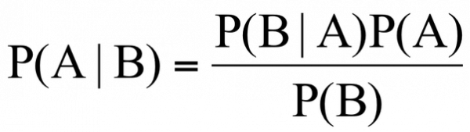
Modeling
Three testing sets for models
1 comment, 4 comment, 10 comment scrapes
Created pipelines to streamline gridsearch process
Types of transformers used:
CountVectorizer
TfidfVectorizer
Types of Estimators used:
Logistic Regression
Multinomial Naive Bayes
Binomial Naive Bayes
Notes:
Naive bayes = prob of A given b
Created new stopwords too
Estimators:
Attempted random forest but the computational costs and results were not to my liking.

Slide 5
Results
Best Dataset:
4+ Comment Scrape
Best Transformer:
TfidfVectorizer
Ngram_range: 1
Max_features: 15000
Stop_words: ‘English’
Best Estimator:
Logistic Regression
C: 1
Penalty: L2
Notes:
Logistic Regression Parameters, C=Regularization strength, Penalty= L2, rest default

Slide 6
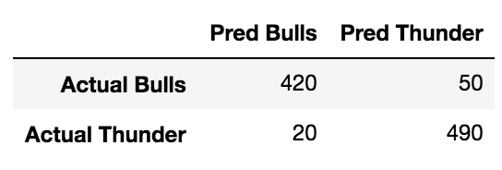
Metrics
Training Accuracy: 95.501%
Test Accuracy: 92.175%
Sensitivity: 0.952
Specificity: 0.889
ROC AUC Score: 0.978
Notes:
Specificity = how good predicting bulls
Confusion matrix was scaled down by a magnitude of 10 and rounded to the tens place.

Slide 7
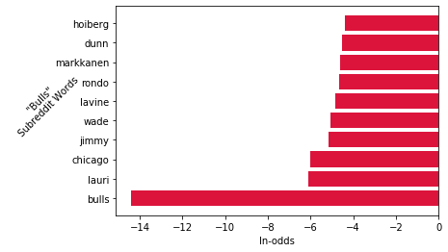
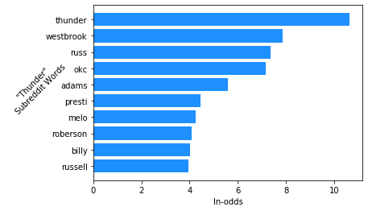

Slide 8
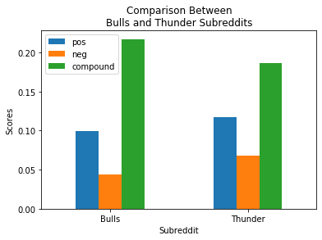
Sentiment Analysis
Notes:
From anova there is a significant difference between the scores of both teams.
Pos pval = 3.9E-28
Neg pval = 7.6E-74
Compound pval 6.7 E-7

Slide 9
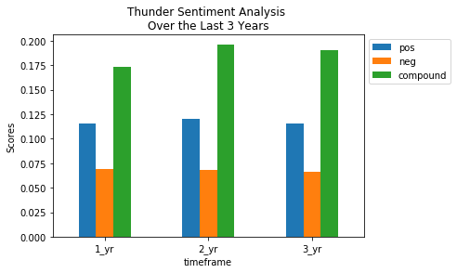
Notes:
Performing Anova on each of the scores grouping by the year yield that there is not a significant difference between the years and their sentiment scores.
None of the pvalues were below an alpha of 0.05
P value for positive was 0.18
Negative = 0.60
Compound = 0.09

Slide 10
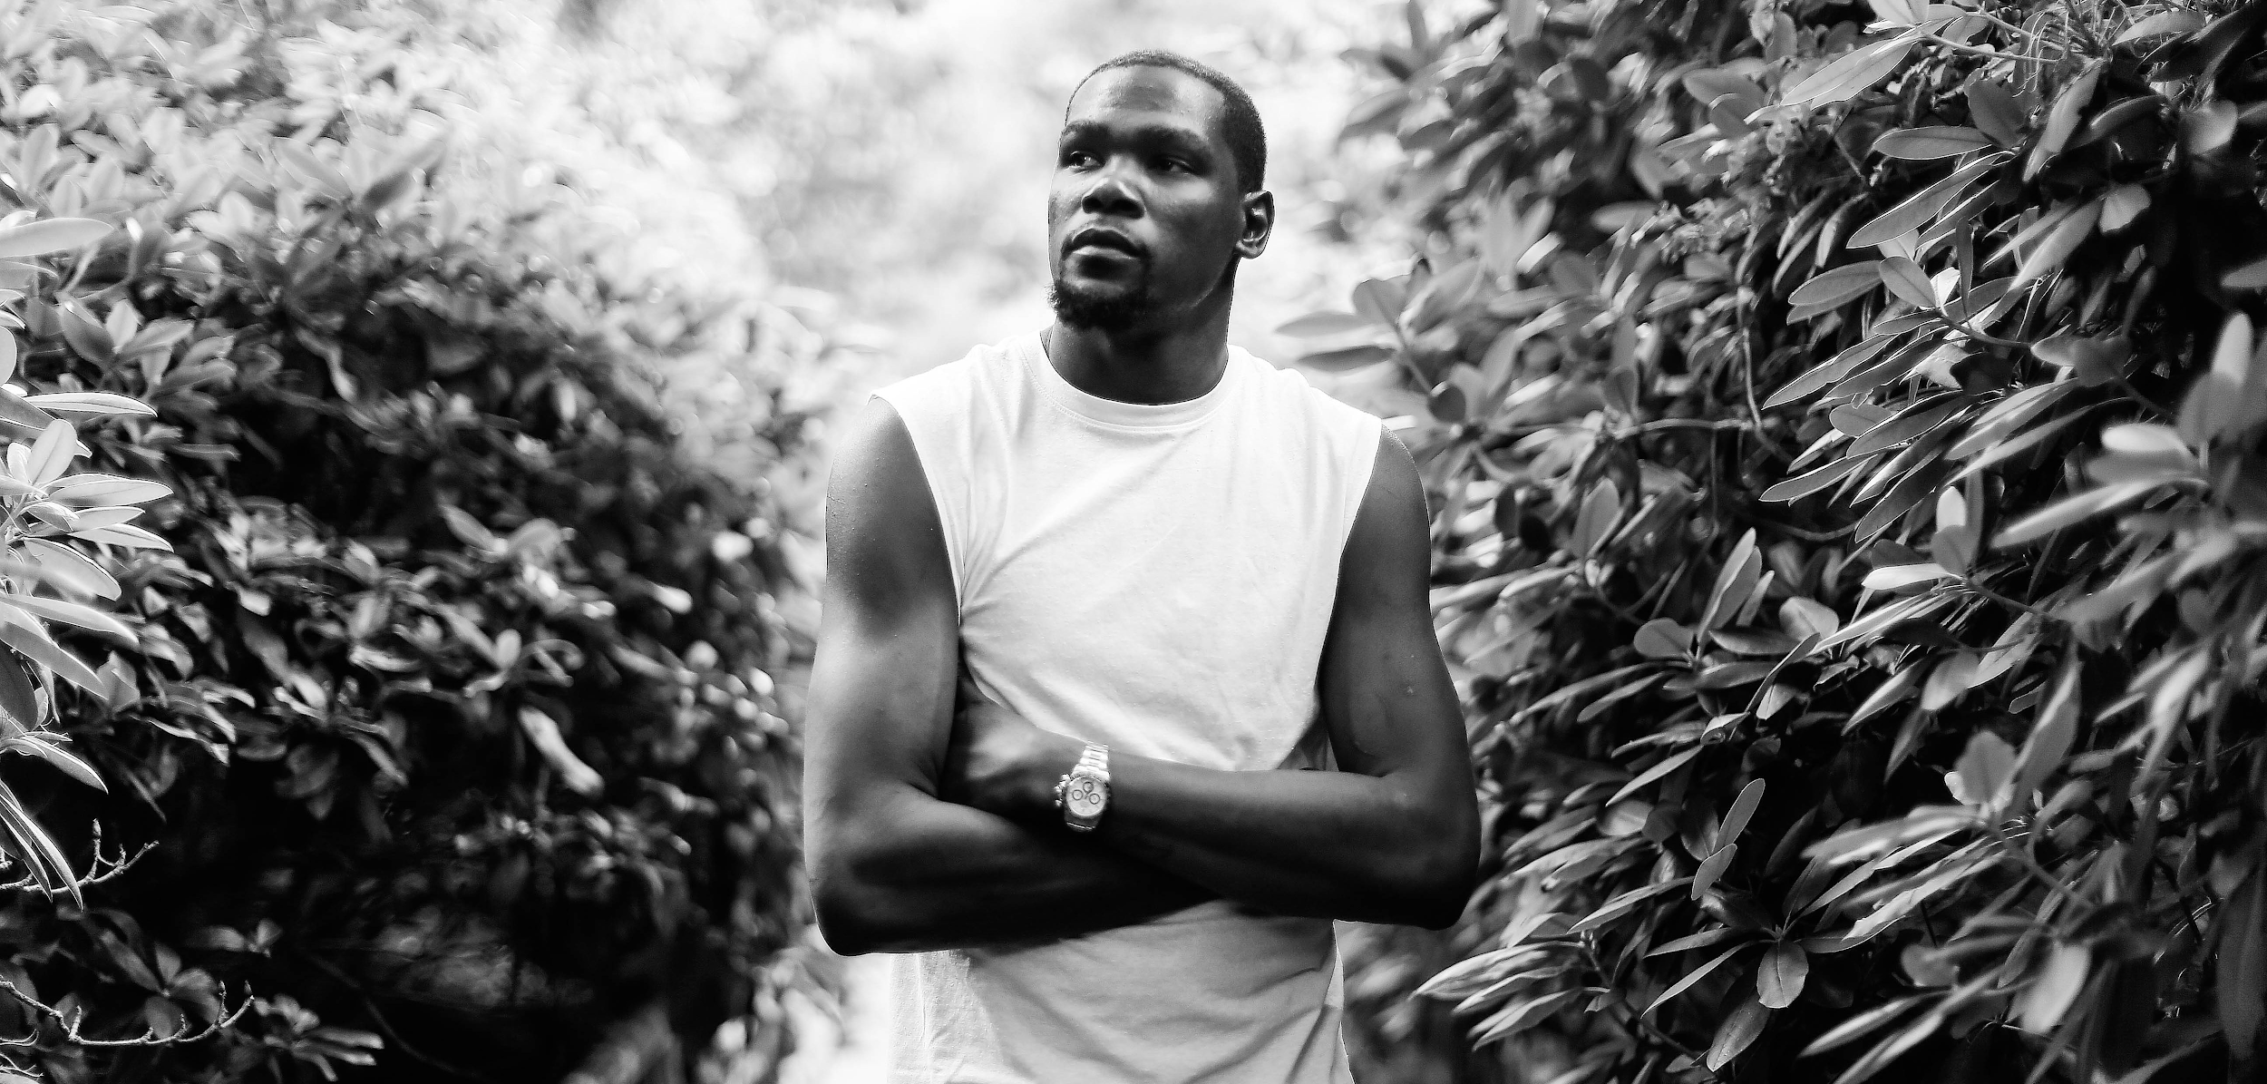

Slide 11
https://www.reddit.com/r/Thunder/comments/cc4jgr/so_long_partner_inspired_by_uroninrobots_post/?utm_source=share&utm_medium=web2x

